Slide 1
Guided Capstone Project
Sonam Devadiga

Slide 2
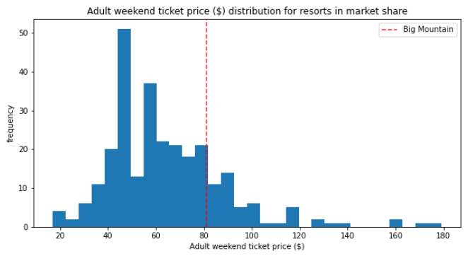
Problem Identification
Big Mountain Resort has been reviewing potential scenarios for either cutting costs or increasing revenue (from ticket prices).
Ticket price is not determined by any set of parameters; the resort is free to set whatever price it likes. However, the resort operates within a market where people pay more for certain facilities, and less for others.
Being able to sense how facilities support a given ticket price is valuable business intelligence.
Every year about 350,000 people ski or snowboard at Big Mountain. This mountain can accommodate skiers and riders of all levels and abilities.
They have some unique facilities for novice as well as experienced skiers which can be value differentiator than the other 330 resorts in the USA.
They have also added new equipment which have increased their operating margin.
So considering this the management wants to re-evaluate the ticket cost and make it fair while being competitive in the market
Fig 1 : Adult weekend ticket price ($) distribution

Slide 3
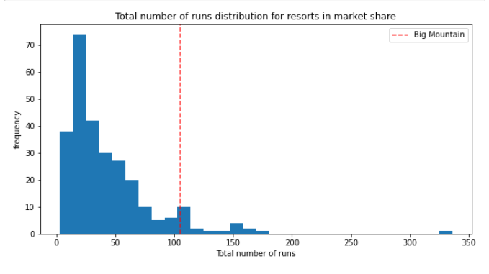
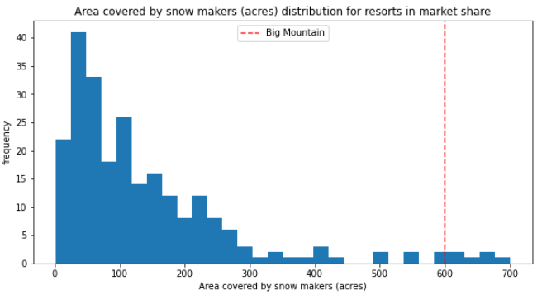
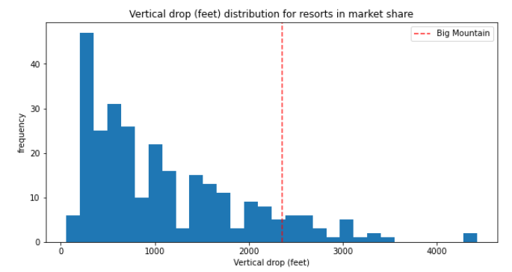
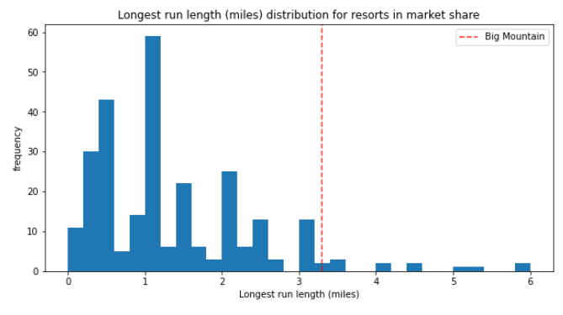
Recommendation and Key Findings
Key Findings :
Features that came up as important in the modeling included:
vertical_drop
Snow Making_ac
total_chairs
fastQuads
Runs
LongestRun_mi
Trams
SkiableTerrain_ac
Fig 2 : Total number of distribution runs
Fig 4 : Vertical drop (feet) distribution
Fig 6: Longest Run length (miles)

Slide 4
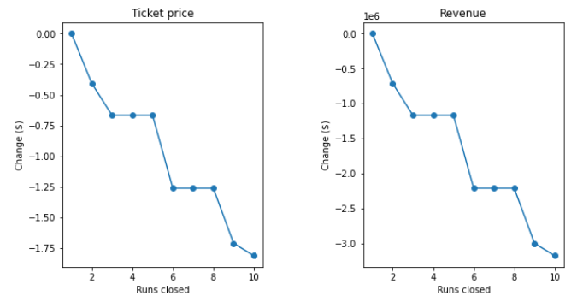
Modeling Results
Scenario 1
Permanently closing down up to 10 of the least used runs. This doesn't impact any other resort statistics
Scenario 2
Increase the vertical drop by adding a run to a point 150 feet lower down but requiring the installation of an additional chair lift to bring skiers back up, without additional snow making coverage
This scenario increases support for ticket price by $8.61.
Over the season, this could be expected to amount to $15065471
The model says closing one run makes no difference. Closing 2 and 3 successively reduces support for ticket price and so revenue. If Big Mountain closes down 3 runs, it seems they may as well close down 4 or 5 as there's no further loss in ticket price. Increasing the closures down to 6 or more leads to a large drop

Slide 5
Modeling Results
Scenario 3
Same as number 2, but adding 2 acres of snow making cover
Scenario 4
Increase the longest run by 0.2 mile to boast 3.5 miles length, requiring an additional snow making coverage of 4 acres
This scenario increases support for ticket price by $9.90.
Over the season, this could be expected to amount to $17322717
Such a small increase in the snow making area makes no difference!
Big Mountain has one of the longest runs. Although it is just over half the length of the longest, the longer ones are rare.
No difference whatsoever. Although the longest run feature was used in the linear model, the random forest model (the one we chose because of its better performance) only has longest run way down in the feature importance list.

Slide 6
Summary and conclusion
Close 1 run
Increase the vertical drop by adding a run to a point 150 feet lower down but requiring the installation of an additional chair lift to bring skiers back up, without increasing snow coverage
Over the season, this could be expected to amount to $15065471

